Slide 1
Lab Session Linear Regression (Implementing Least Square Error Fit and Gradient Descent)
Dr. Jasmeet Singh
Assistant Professor, CSED
TIET, Patiala

Slide 2
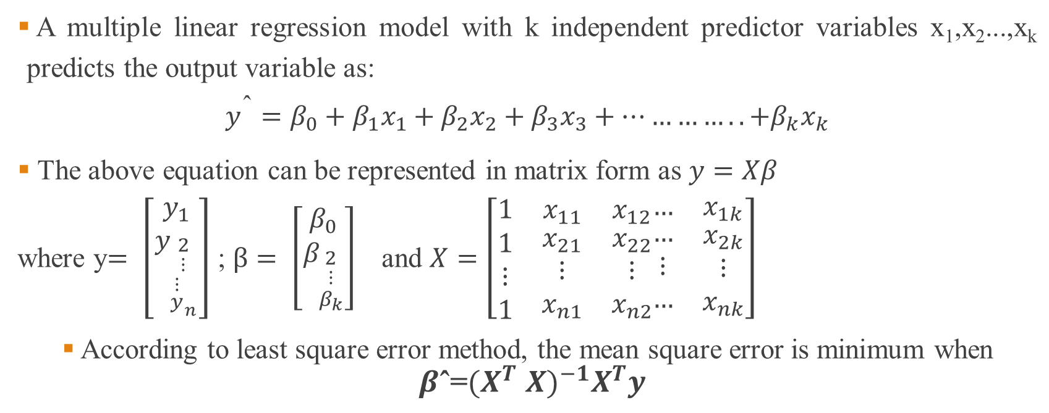
Multiple Linear Regression- Least Square Error Fit
A multiple linear regression model with k independent predictor variables x₁,x₂...,x_{k} predicts the output variable as:
$$y^{\text{ˆ}}=β_{0}+β_{1}x_{1}+β_{2}x_{2}+β_{3}x_{3}+…………..{+β}_{k}x_{k}$$
The above equation can be represented in matrix form as $y=Xβ$
where y$= \left[\begin{matrix}y_{1} \\ y_{\begin{aligned}2 \\ ⋮ \\ {\begin{aligned}⋮ \\ y\end{aligned}}_{n}\end{aligned}}\end{matrix}\right]$ ; $β= \left[\begin{matrix}β_{0} \\ β_{\begin{aligned}2 \\ ⋮ \\ β_{k}\end{aligned}}\end{matrix}\right]$and $X=\left[\begin{matrix}1 & x_{11} & x_{12} \\ \begin{aligned}1 \\ ⋮ \\ 1\end{aligned} & \begin{aligned}x_{21} \\ ⋮ \\ x_{n1}\end{aligned} & \begin{aligned}x_{22} \\ ⋮ \\ x_{n2}\end{aligned}\end{matrix}\begin{matrix}… & x_{1k} \\ \begin{aligned}… \\ ⋮ \\ …\end{aligned} & \begin{aligned}x_{2k} \\ ⋮ \\ x_{nk}\end{aligned}\end{matrix}\right]$
According to least square error method, the mean square error is minimum when $β\text{ˆ}\text{=}{{(X}^{T} X)}^{−1}X^{T}y$

Slide 3
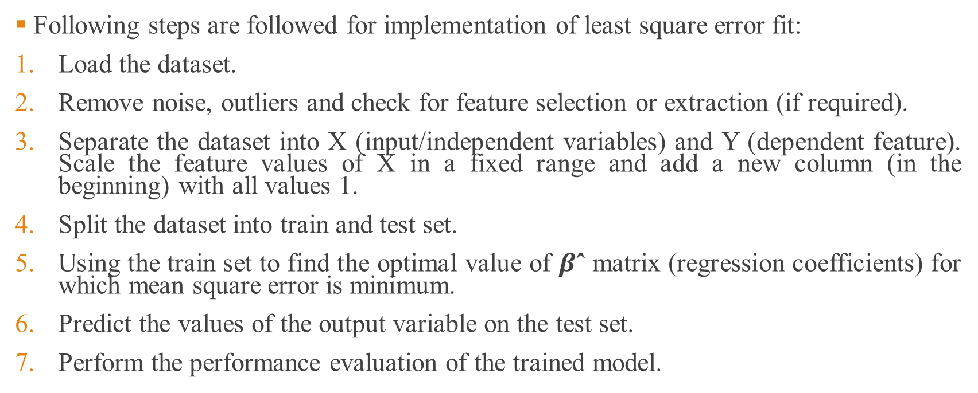
Least Square Error Fit (LSE)- Step by Step
Following steps are followed for implementation of least square error fit:
Load the dataset.
Remove noise, outliers and check for feature selection or extraction (if required).
Separate the dataset into X (input/independent variables) and Y (dependent feature). Scale the feature values of X in a fixed range and add a new column (in the beginning) with all values 1.
Split the dataset into train and test set.
Using the train set to find the optimal value of $β\text{ˆ}$ matrix (regression coefficients) for which mean square error is minimum.
Predict the values of the output variable on the test set.
Perform the performance evaluation of the trained model.

Slide 4
Step 1 (LSE): Load the Dataset
For implementation of multiple linear regression using least square error fit , we will be using USA housing dataset.
Code :
import pandas as pd
df=pd.read_csv('C:/Users/jasme/Downloads/USA_Housing.csv’)
You can download the dataset from the following link:
https://drive.google.com/file/d/1O_NwpJT-8xGfU_-3llUl2sgPu0xllOrX/view?usp=sharing

Slide 5
Step 1 (LSE): Load the Dataset Contd…..
We can check the information regarding dataset using the following code:
df.info()
Output:<class 'pandas.core.frame.DataFrame'>
RangeIndex: 5000 entries, 0 to 4999
Data columns (total 6 columns):
# Column Non-Null Count Dtype
--- ------ -------------- -----
0 Avg. Area Income 5000 non-null float64
1 Avg. Area House Age 5000 non-null float64
2 Avg. Area Number of Rooms 5000 non-null float64
3 Avg. Area Number of Bedrooms 5000 non-null float64
4 Area Population 5000 non-null float64
5 Price 5000 non-null float64
dtypes: float64(6)
memory usage: 234.4 KB

Slide 6
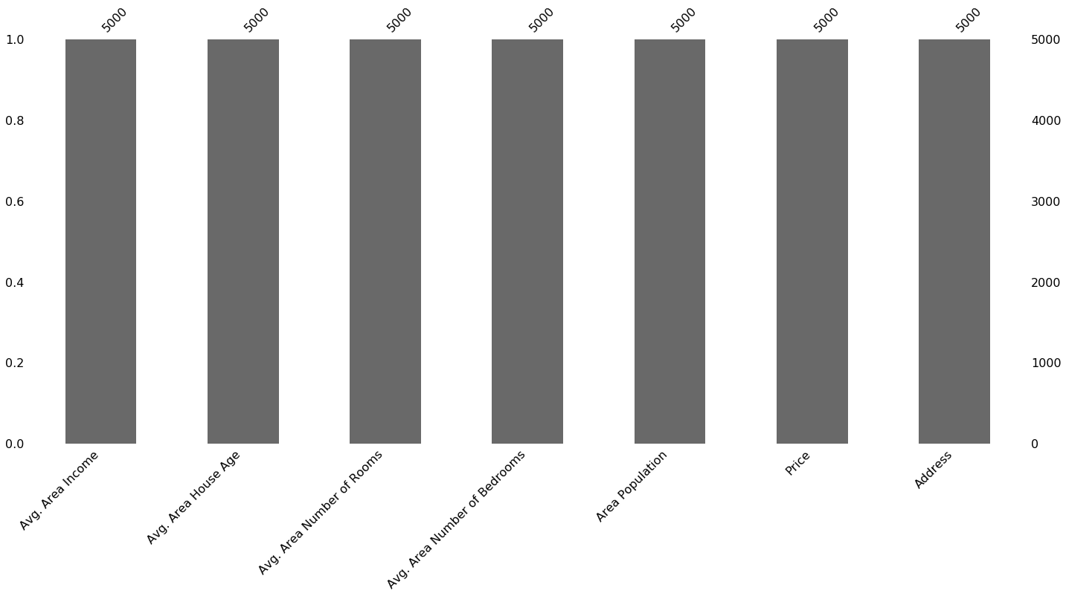
Step 2 (LSE): Removing noise
We can check for null values using missingno library as shown below:
Code:
import missingno as ms
ms.bar(df)
As shown in figure, all columns have 5000 entries. So, there is no missing values.

Slide 7
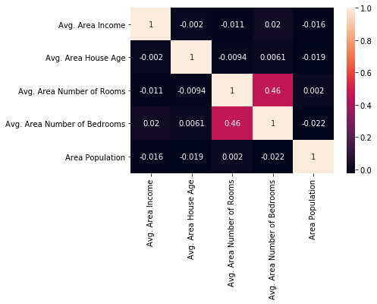
Step 2 (LSE): Checking Redundancy among features
We can check redundancy between input features by plotting heatmap of correlation between the input features:
Code:
import seaborn as sns
sns.heatmap(df.iloc[:,0:5].corr(),annot=True)
Since correlation between features is less (not greater than 0.7 or 0.8), so feature selection/extraction is not required.

Slide 8
Step 3 (LSE): Split Input & Output Features
Separate the dataset into X (input/independent variables) and Y (dependent feature).
Scale the feature values of X in a fixed range
Add a new column (in the beginning) with all values 1.
Code:
import numpy as np
X=df.iloc[:,0:5]
Y=df.iloc[:,5]
Y=np.array(Y)
Y=Y.reshape(-1,1)
from sklearn.preprocessing import StandardScaler
scaler=StandardScaler()
X_scaled=scaler.fit_transform(X)
X_scaled= np.insert(X_scaled, 0, values=1, axis=1)

Slide 9
Step 4 (LSE): Train/Test Split
We can split the train and test sets using train/test split of sklearn.model_selection as follows:
Code:
from sklearn.model_selection import train_test_split
X_train, X_test, y_train, y_test = train_test_split(X_scaled, Y, test_size=0.3, random_state=42)
Parameters:
test_size is the percentage of test set from the total dataset; random_state s used for initializing the internal random number generator, which will decide the splitting of data into train and test indices
If random_state is None or np.random, then a randomly-initialized RandomState object is returned.
If random_state is an integer, then it is used to seed a new RandomState object.

Slide 10
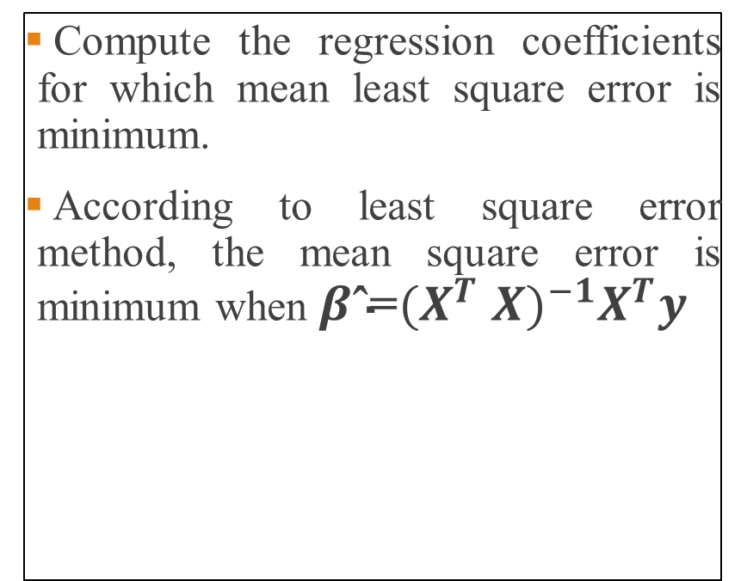
Step 5 (LSE): Finding Regression Coefficients
Compute the regression coefficients for which mean least square error is minimum.
According to least square error method, the mean square error is minimum when $β\text{ˆ}\text{=}{{(X}^{T} X)}^{−1}X^{T}y$
Code:
A=X_train.T.dot(X_train)
B=np.linalg.inv(A)
C=B.dot(X_train.T)
beta=C.dot(y_train)
print(beta)

Slide 11
Step 6 (LSE) : Predicting values on test set
In this step, we predict the values of output variable on the test set.
It is done by multiplying X_test set with optimal Beta matrix as hown in the code below.
Code:
y_predict=X_test.dot(beta)
print(y_predict)

Slide 12
Step 7 (LSE): Performance Evaluation
We check the performance of the trained model by computing following error between the predicted and actual values:
Mean Square Error
Root Mean Square Error
R2_score
Code:
error=y_test-y_predict
square_error=np.power(error,2)
sum_square_error=np.sum(square_error)
mean_square_error=sum_square_error/len(y_predict)
print(mean_square_error)
rms_error=np.sqrt(mean_square_error)
print(rms_error)
y_mean=np.mean(y_test)
total_variance=np.sum((y_test-y_mean)**2)
print(1-sum_square_error/total_variance)

Slide 13
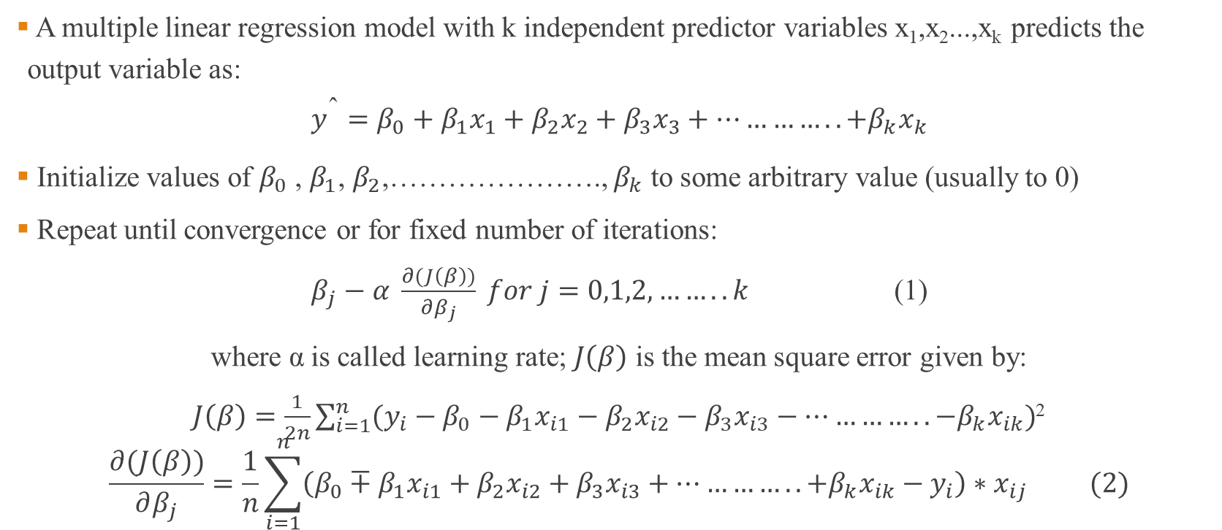
MLR: Gradient Descent Optimization
A multiple linear regression model with k independent predictor variables x₁,x₂...,x_{k} predicts the output variable as:
$$y^{\text{ˆ}}=β_{0}+β_{1}x_{1}+β_{2}x_{2}+β_{3}x_{3}+…………..{+β}_{k}x_{k}$$
Initialize values of $β_{0}$ , $β_{1}$, $β_{2}$,…………………., $β_{k}$ to some arbitrary value (usually to 0)
Repeat until convergence or for fixed number of iterations:
$β_{j}−α \frac{∂(J\left(β\right))}{∂β_{j}} for j=0,1,2,……..k$ (1)
where α is called learning rate; $J\left(β\right)$ is the mean square error given by:
$J\left(β\right)=\frac{1}{2n}\sum_{i=1}^{n}{(y_{i}−β_{0}−β_{1}x_{i1}−β_{2}x_{i2}−β_{3}x_{i3}−…………..{−β}_{k}x_{ik})}$²
$$\frac{∂(J\left(β\right))}{∂β_{j}}=\frac{1}{n}\sum_{i=1}^{n}{\left(β_{0}∓β_{1}x_{i1}+β_{2}x_{i2}+β_{3}x_{i3}+…………..{+β}_{k}x_{ik}−y_{i}\right)∗x_{ij}} (2)$$

Slide 14
Gradient Descent Optimization: Step- by-Step
Following steps are followed for implementation of gradient descent optimization:
Load the dataset.
Remove noise, outliers and check for feature selection or extraction (if required).
Separate the dataset into X (input/independent variables) and Y (dependent feature). Scale the feature values of X in a fixed range.
Split the dataset into train and test set.
Initialize values of regression coefficients to zero and update the coefficients using equations 1 and 2 (in previous slide) for fixed number of iterations and fixed learning rate (simultaneous update).
Predict the values of the output variable on the test set.
Perform the performance evaluation of the trained model.
* Steps 1 to 4 are same as Least Square Error fit (except adding column with all 1’s at the beginning)

Slide 15
Step 5 (Gradient Descent): Update Regression Coefficients
beta=np.zeros(6)
number_of_iterations=1000
learning_rate=0.01
for i in range(number_of_iterations):
x0_gradient=0
x1_gradient=0
x2_gradient=0
x3_gradient=0
x4_gradient=0
x5_gradient=0
for j in range(len(X_train)):
a=X_train[j,0]
b=X_train[j,1]
c=X_train[j,2]
d=X_train[j,3]
e=X_train[j,4]
f=Y_train[j]
x0_gradient+=(beta[0]+(beta[1]*a)+(beta[2]*b)+(beta[3]*c)+(beta[4]*d)+(beta[5]*e)-f)
x1_gradient+=((beta[0]+(beta[1]*a)+(beta[2]*b)+(beta[3]*c)+(beta[4]*d)+(beta[5]*e)-f)*a)
x2_gradient+=((beta[0]+(beta[1]*a)+(beta[2]*b)+(beta[3]*c)+(beta[4]*d)+(beta[5]*e)-f)*b)
x3_gradient+=((beta[0]+(beta[1]*a)+(beta[2]*b)+(beta[3]*c)+(beta[4]*d)+(beta[5]*e)-f)*c)
x4_gradient+=((beta[0]+(beta[1]*a)+(beta[2]*b)+(beta[3]*c)+(beta[4]*d)+(beta[5]*e)-f)*d)
x5_gradient+=((beta[0]+(beta[1]*a)+(beta[2]*b)+(beta[3]*c)+(beta[4]*d)+(beta[5]*e)-f)*e)
beta[0]=beta[0]-learning_rate/n*x0_gradient
beta[1]=beta[1]-learning_rate/n*x1_gradient
beta[2]=beta[2]-learning_rate/n*x2_gradient
beta[3]=beta[3]-learning_rate/n*x3_gradient
beta[4]=beta[4]-learning_rate/n*x4_gradient
beta[5]=beta[5]-learning_rate/n*x5_gradient
print(beta)

Slide 16
Step 6: Predict Values on test set
In this step, we predict the values of output variable on the test set.
It is done by multiplying X_test set (after adding column with 1 value) with optimal Beta matrix as hown in the code below.
Code:
X_test=np.insert(X_test,0,values=1,axis=1)
beta=np.array(beta).reshape(-1,1)
y_predict=X_test.dot(beta)

Slide 17
Step 7 (Gradient Descent): Performance Evaluation
We check the performance of the trained model by computing following error between the predicted and actual values:
Mean Square Error
Root Mean Square Error
R2_score
Code:
error=y_test-y_predict
square_error=np.power(error,2)
sum_square_error=np.sum(square_error)
mean_square_error=sum_square_error/len(y_predict)
print(mean_square_error)
rms_error=np.sqrt(mean_square_error)
print(rms_error)
y_mean=np.mean(y_test)
total_variance=np.sum((y_test-y_mean)**2)
print(1-sum_square_error/total_variance)

Slide 18
MLR: Inbuilt Functions in Python
We can also use inbuilt, function of Python.
For using inbuilt function, steps 1 to 4 are same as for gradient descent optimization.
In step 5, we fit and transform on the training data using the following code:
from sklearn.linear_model import LinearRegression
model=LinearRegression()
model.fit(X_train,y_train)
In Step 6, we predict the values of output variable on test set as follows:
pred=model.predict(X_test)
In Step 7, we perform performance evaluation using following code:

Slide 19
MLR: Inbuilt Functions in Python Contd….
In Step 7, we perform performance evaluation using following code:
from sklearn import metrics
print(metrics.mean_squared_error(pred,y_test))
print(metrics.mean_absolute_error(pred,y_test))
print(np.sqrt(metrics.mean_squared_error(pred,y_test)))
print(metrics.r2_score(y_test, pred))

